Slide 1

IOD Capstone Project
Predicted Netflix Revenue
Christopher Waters
Data Science & AI

Slide 2
Agenda
Introduction - Industry Domain and Goals
Featured Dataset - Collect - Clean - Manipulate
Analysis - EDA - Visualisation
Modelling - Train - Split - Evaluate
Conclusions - Recommendations

Slide 3


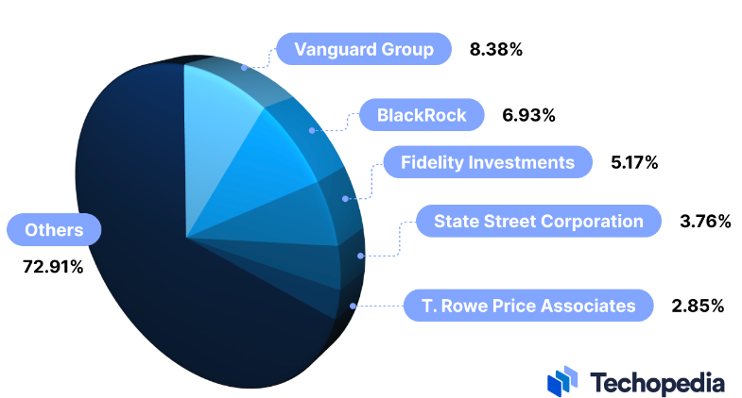
Introduction – Industry and Shareholders
Netflix is the most subscribed video-on-demand (VoD) streaming media service with over 260 million paid memberships in more than 190 countries as of July 2024.
It is the first and longest-running VoD streaming platform, established in 2007.
Institutional shareholders include the Vanguard Group, BlackRock and Fidelity Investments.
Largest insider shareholders include Reed Hastings and Ted Sarandos (2%).
As of 2024, Netflix has a net worth of more than $263 billion - the majority of which comes from subscriptions.

Slide 4

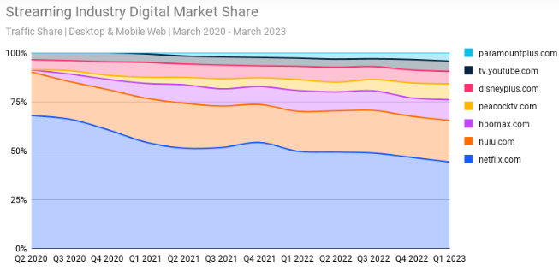
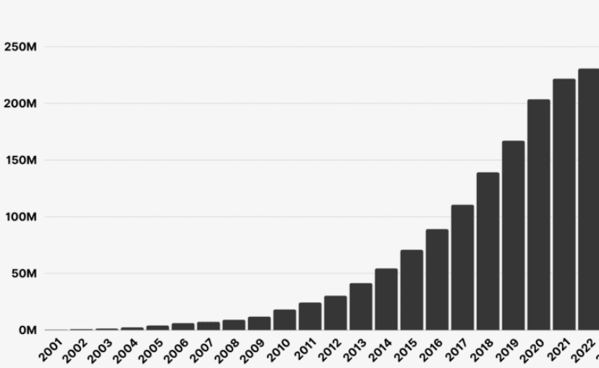
Business Problem
Despite being the most subscribed VoD streaming platform in the world, Netflix has experienced stiff competition from alternatives such as Amazon Prime, HBO Max and Disney+ in recent years. Specifically, Disney+ which has amassed over 150 million subscribers since its inception in November 2019. In 2022, Netflix saw the shortest growth in new subscriptions since 2012.
With the emergence and success of these alternative streaming platforms, as well as a recent decrease in VoD streaming market share, Netflix could experience either a decrease or stagnation in subscription-based revenue.

Slide 5
Business and Data and Questions
Business Question – Based on the total amount subscribers contributed over a specific period, what will the predicted revenue average be?
Data Question – What difference would an increase in the number of ‘Premium’ users have on the total revenue average?

Slide 6




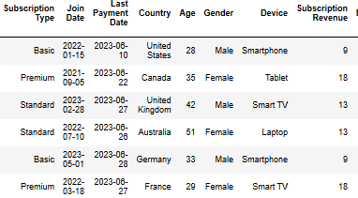
Featured Data
Data consisted of 2500 subjects aged 26-51 from nine countries who had Joined Netflix between September 2021 - June 2023 (no missing values).
Last payment period was June-July 2023 (no cancelled subscriptions between join date and last pay date).
Subscription Revenue was divided into 3 distinct values representing monthly revenue (Basic: 9, Standard: 13, and Premium 18).
Cleaned data comprised of 2423 users who joined Netflix between March December 2022.

Slide 7
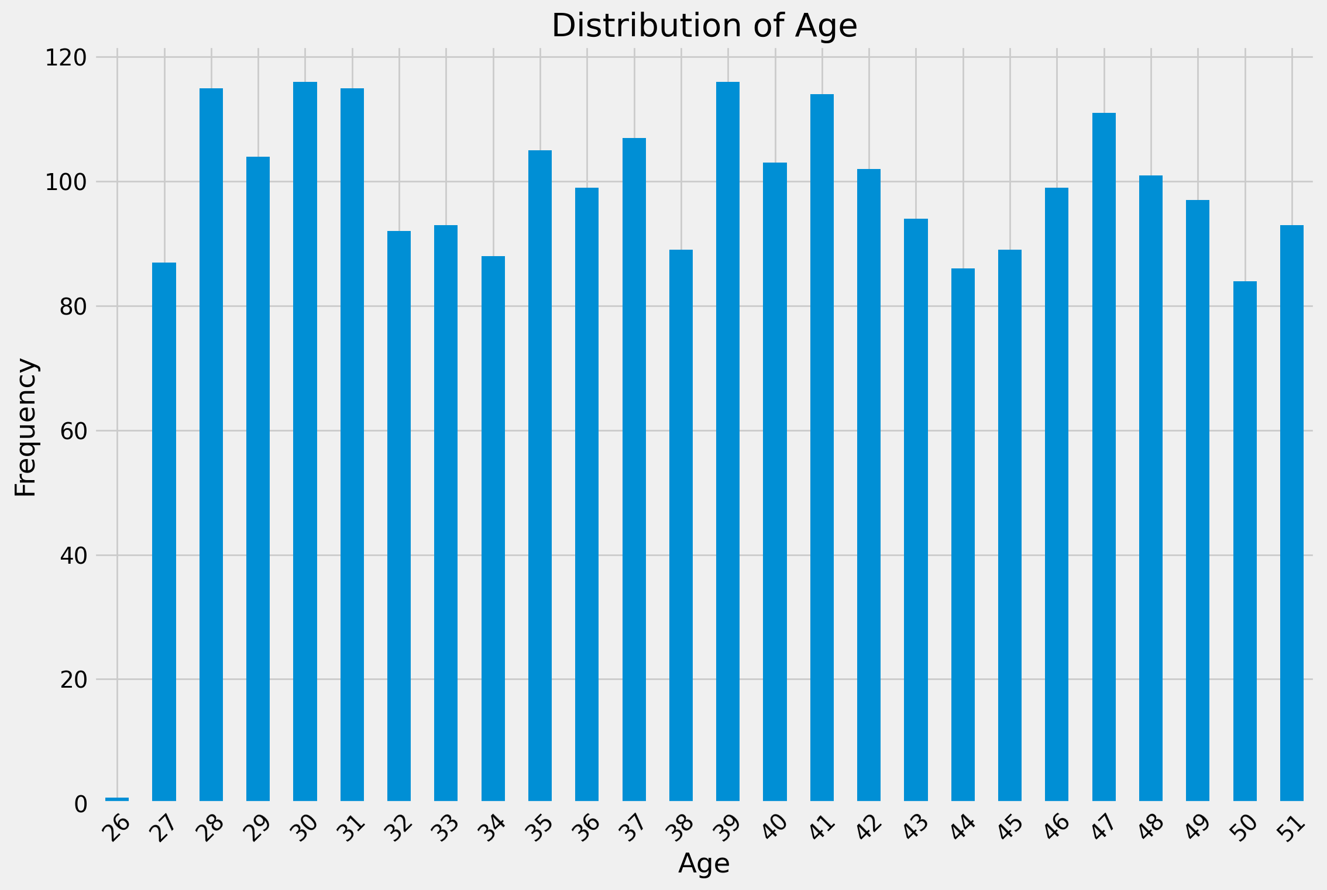
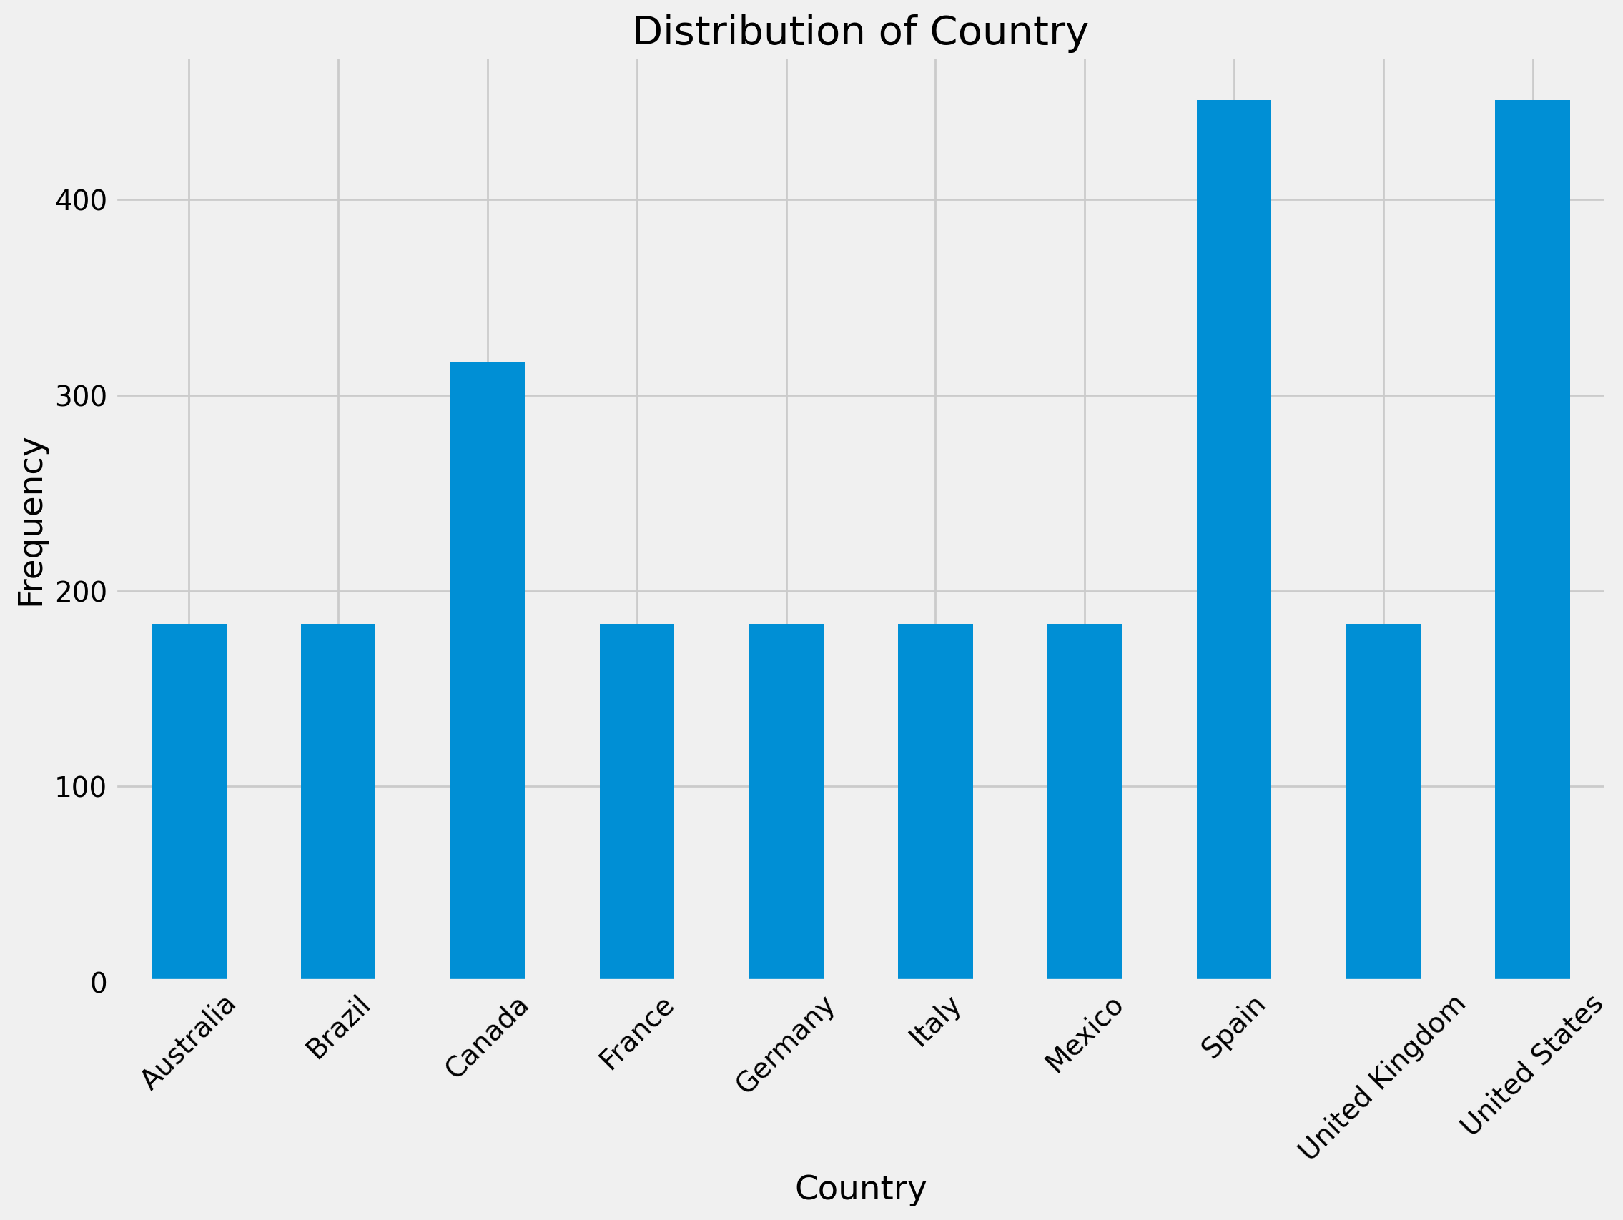
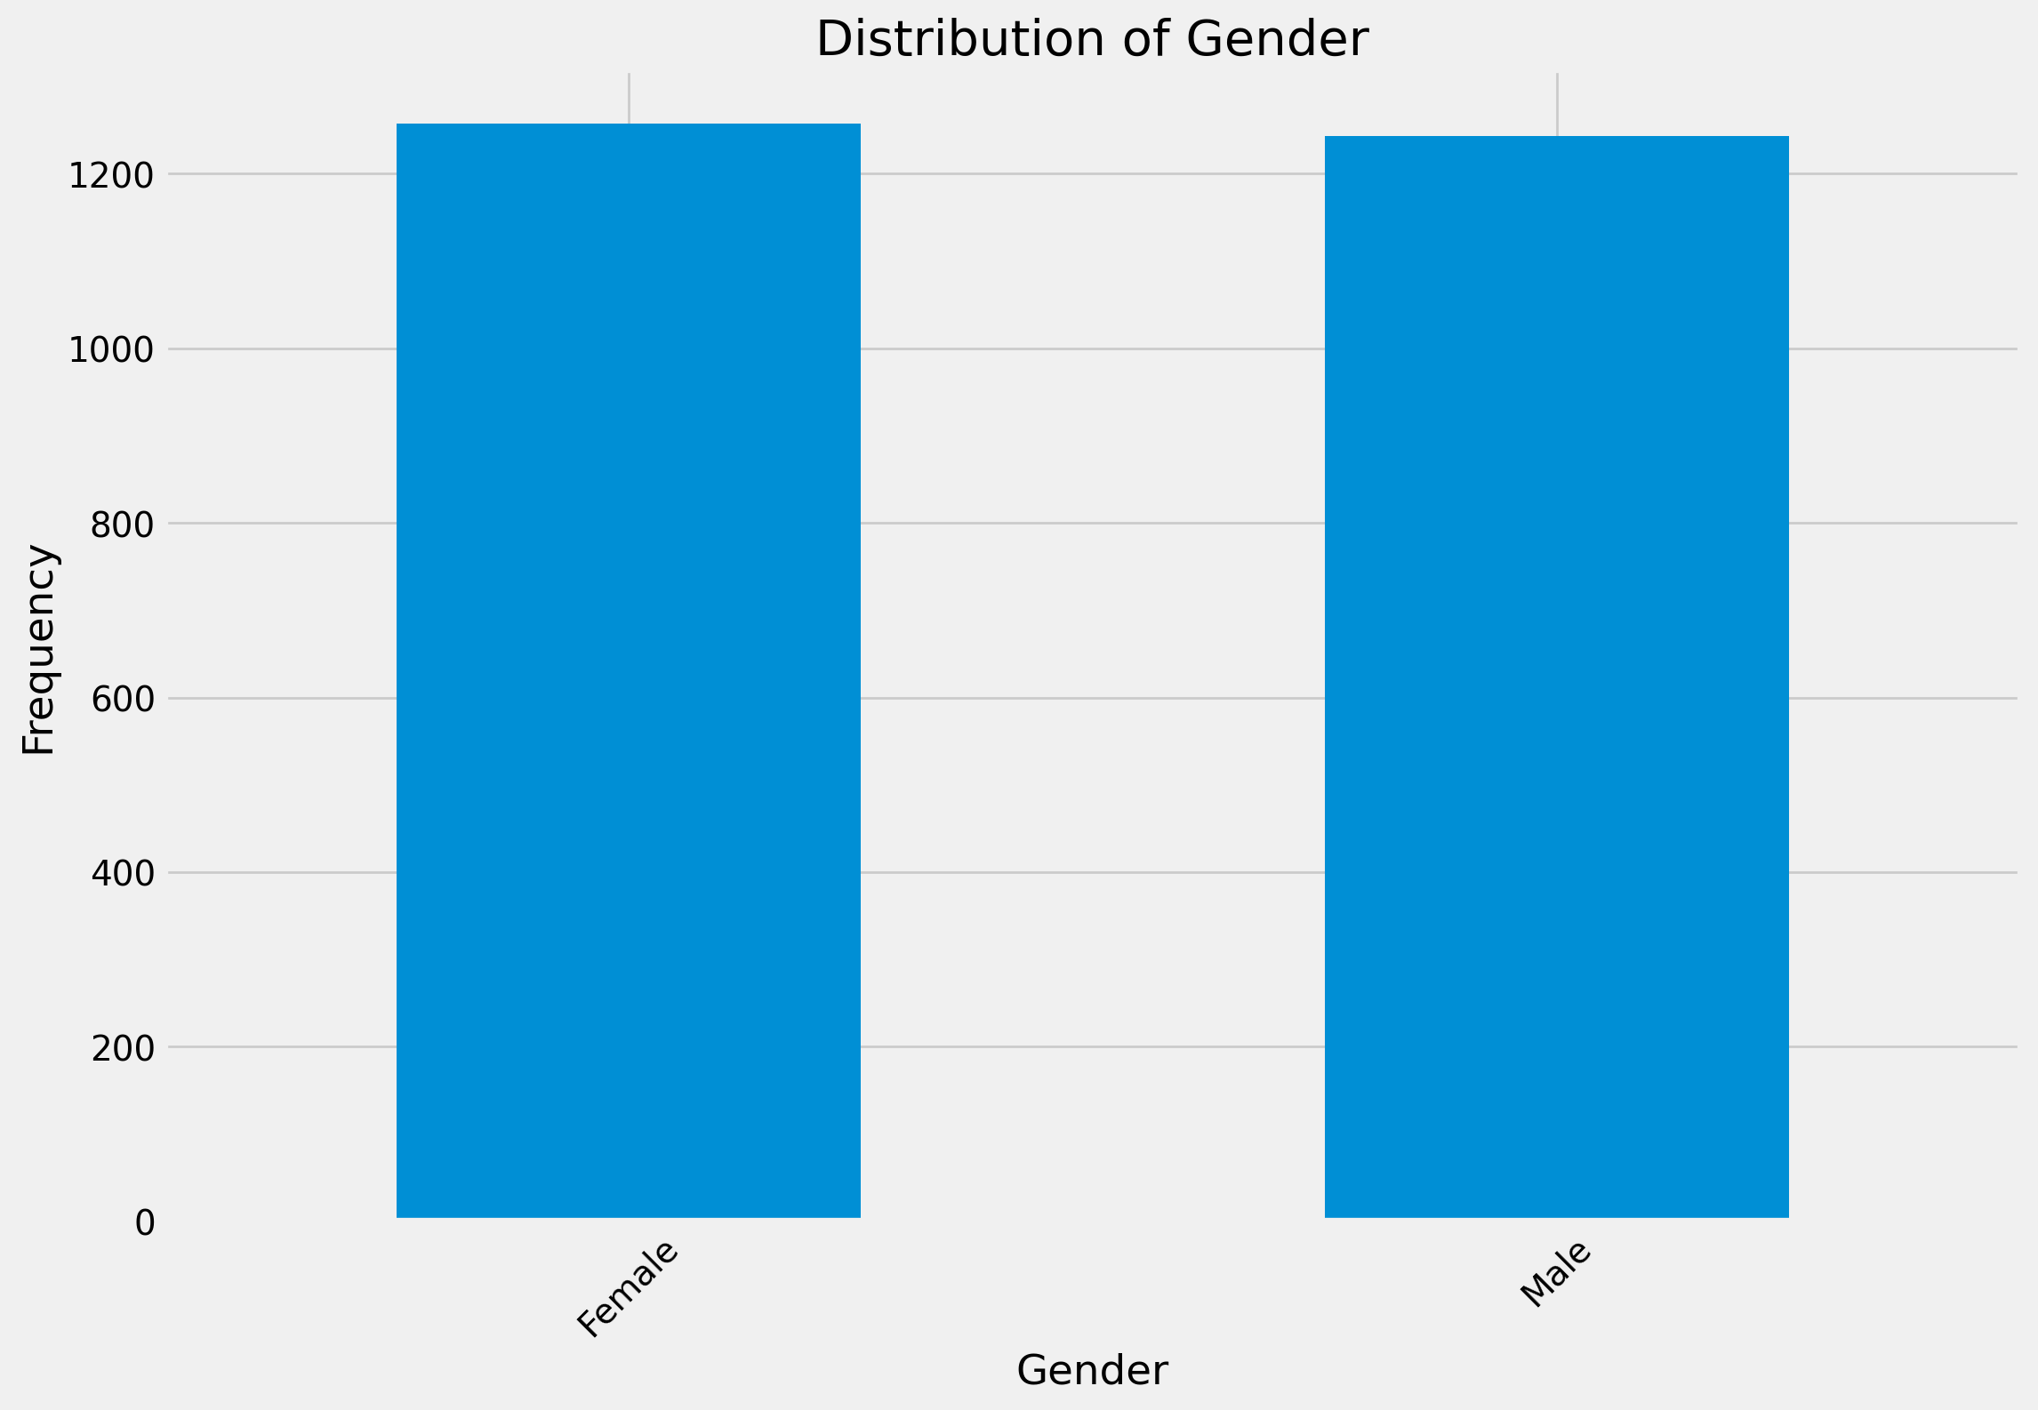
EDA: Demographic Histograms

Slide 8


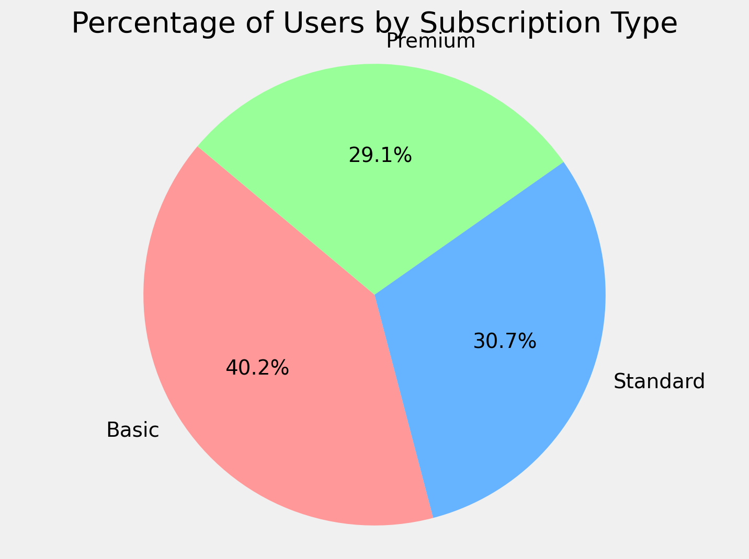
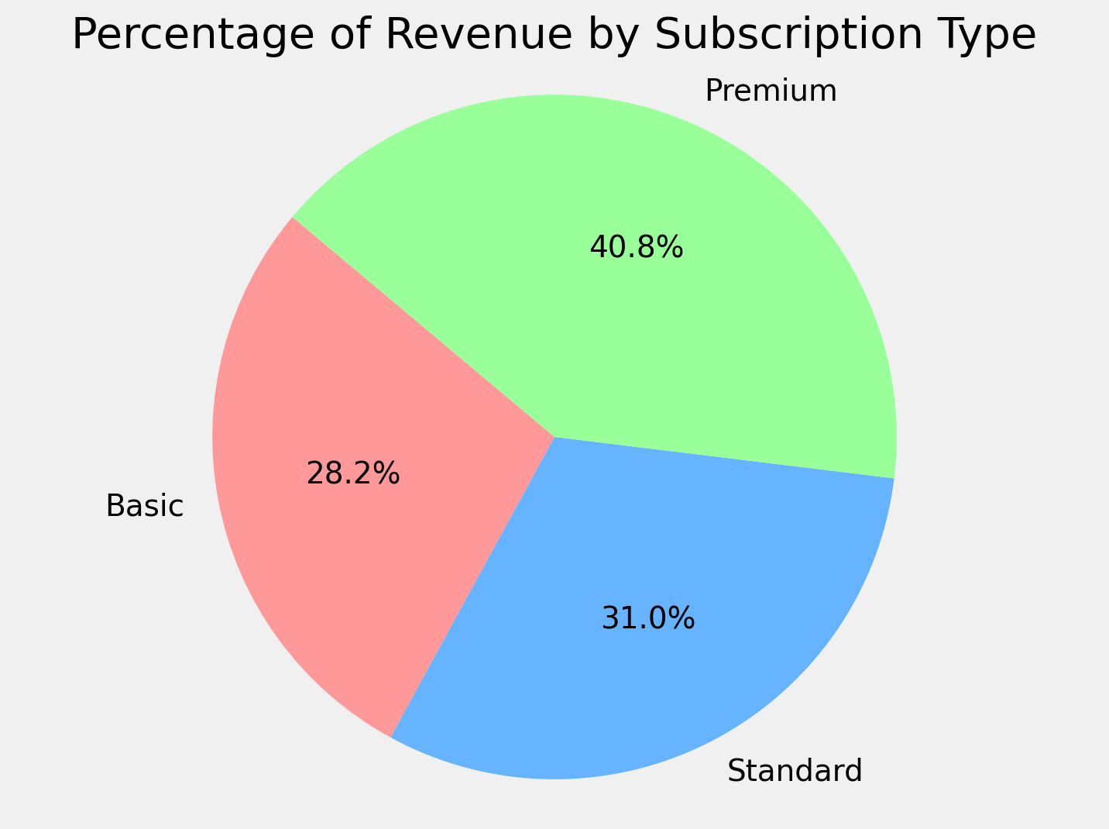
EDA: Percentage of Users and Total Revenue by Subscription Type
29.1% of users were on a ‘Premium’ subscription plan.
40.8% of total revenue came from ‘Premium’ users.

Slide 9
Modelling Overview
Pre-Processing Data
Choosing Models
Hyperparameter Tuning
Train Models
Feature Engineering
Define target variable
Define and select predictors based on feature importance
Random Forest
Decision Tree
SVR
XGBoost
KNN
Gradient Boosting
LightGBM
Find optimal hyperparameters for each model.
Train and evaluate models with chosen hyperparameters.
9

Slide 10
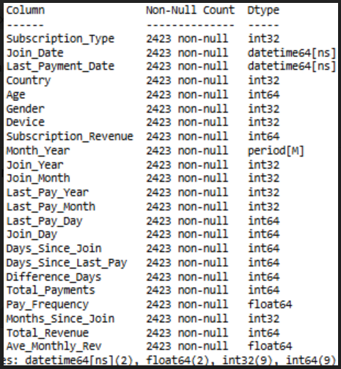
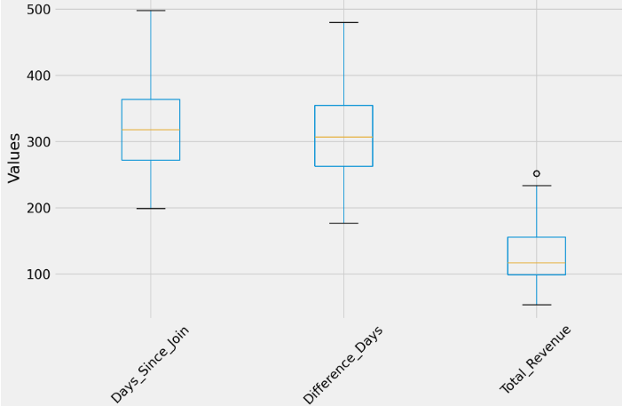
Feature Engineering
Additional features were extracted from the existing data.
Target variable (Total Revenue) was created to represent the total amount each subscriber paid from March-December. Total Revenue values varied from 54-254.
.
Numeric features for Day, Month and Year were generated from both Join Date and Last Payment Date. Total Payments reflected the number of payments of each user.
Other numeric features included Days Since Join, Days Since Last Pay and Difference Day which showed the number of days between.
Float features included Pay Frequency and Average Monthly Revenue.

Slide 11
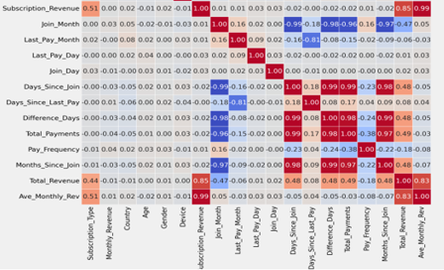

Feature Correlations with Target
Correlation matrix showed moderate-to-strong correlations between target variable and; ‘Subscription_Type’, ‘Subscription_Revenue’, ‘Join_Month’, ‘Days_Since_Join’, ‘Difference_Days’, ‘Total_Payments’, ‘Months_Since_Join’ and ‘Ave_Monthly_Rev’.

Slide 12
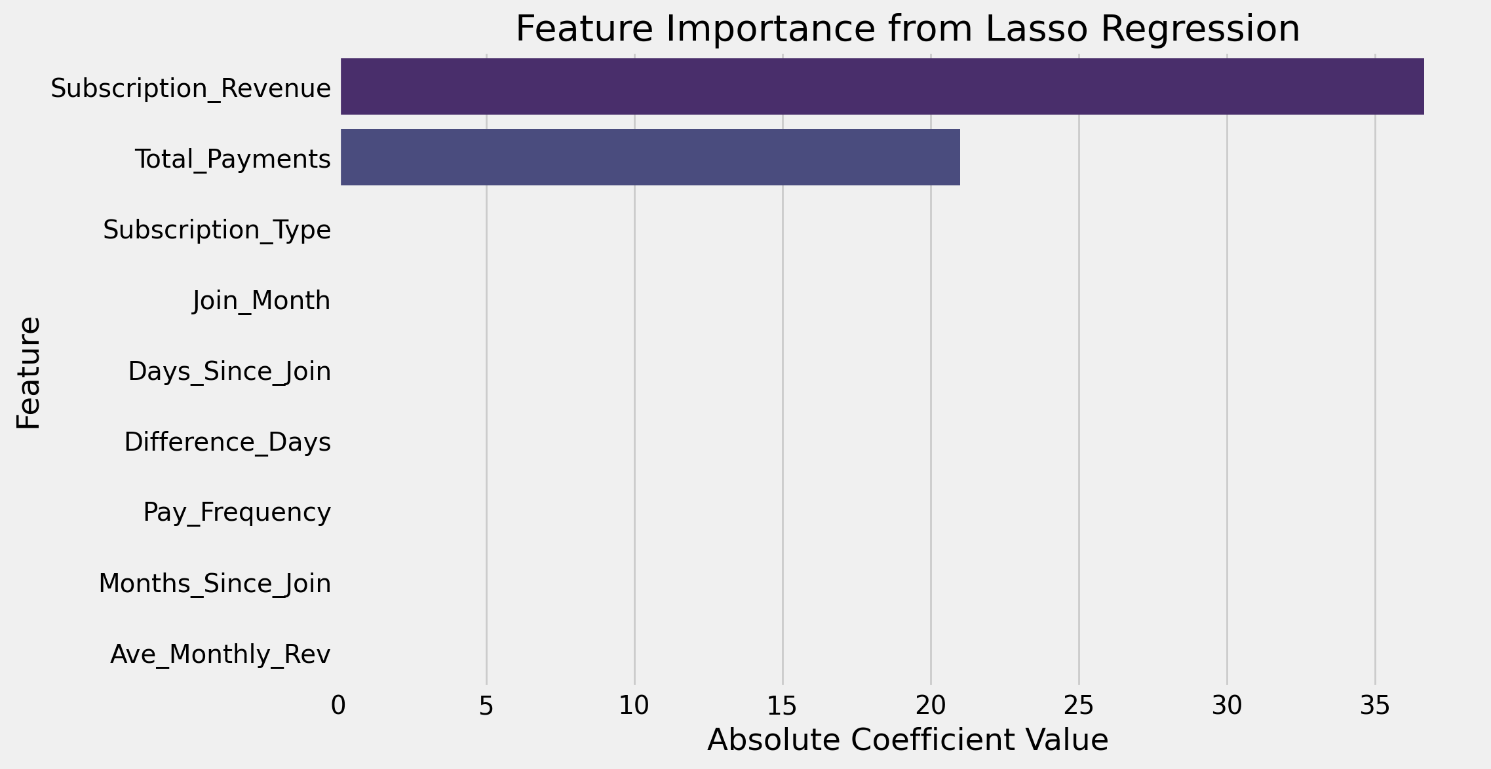
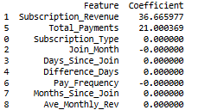
Feature Importance
To address multiple features being highly correlated with each other, Lasso Regularization was used to assess the importance of each feature on the target variable.

Slide 13
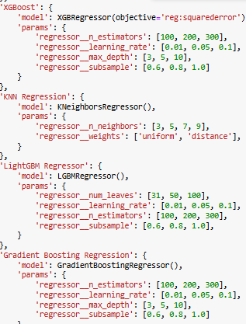
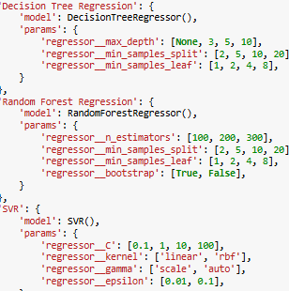
Regression Model Pipeline
Each regression model was fitted through a pipeline to evaluate their performance accuracy.
Data was first split into a train set and test set. The test set will consist of 20% of the data (485 cases) which will be the focus of model performance. R2 Scores will determine how well the predictor features explained the variance of target variable.
Each model was evaluated based on their 5-fold cross-validation scores and hyperparameters.

Slide 14
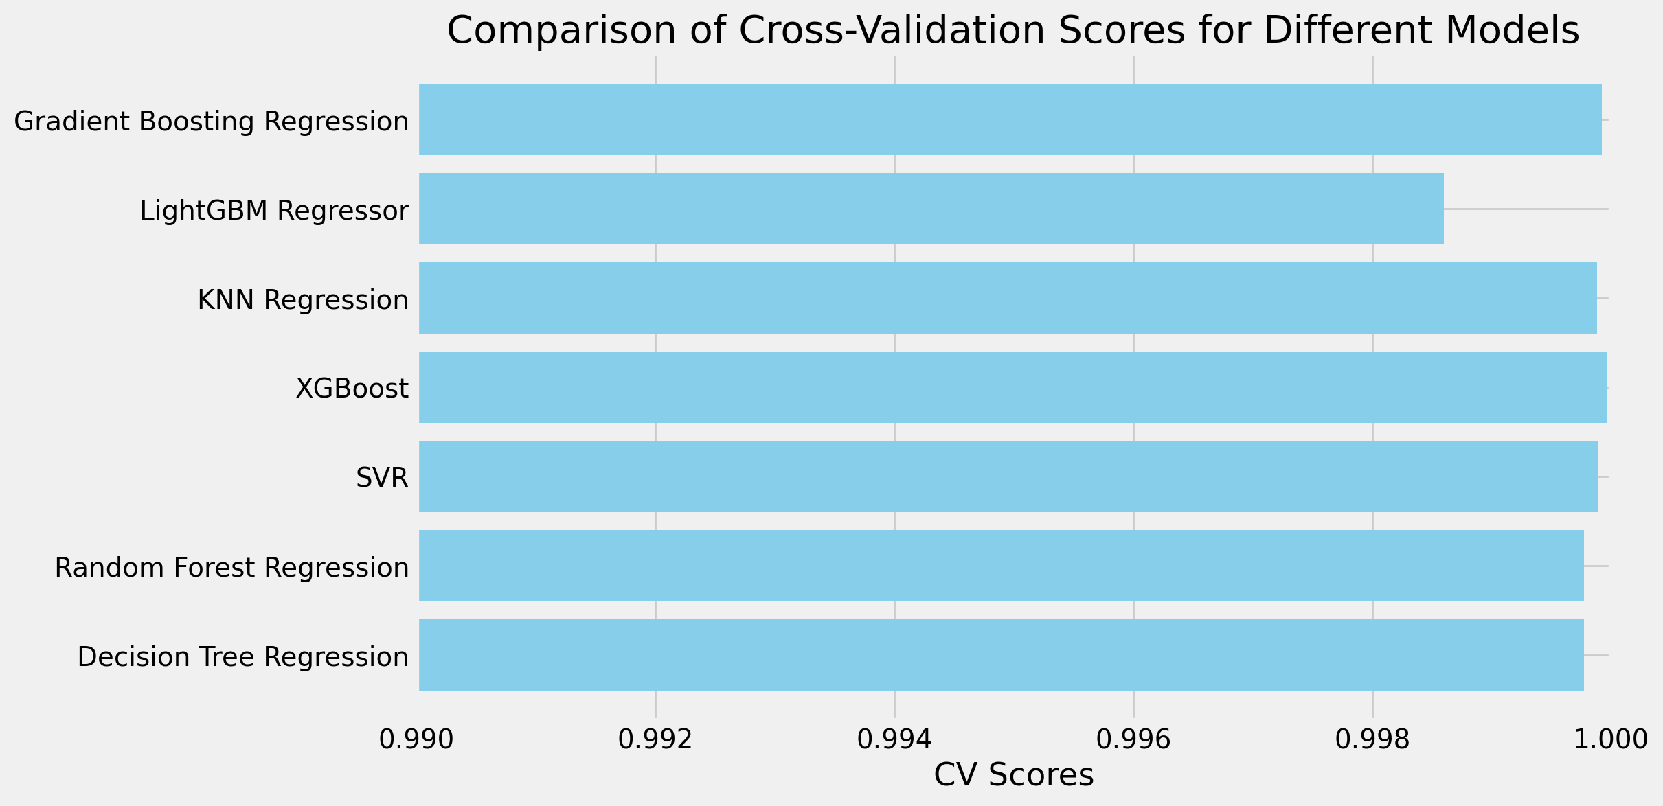
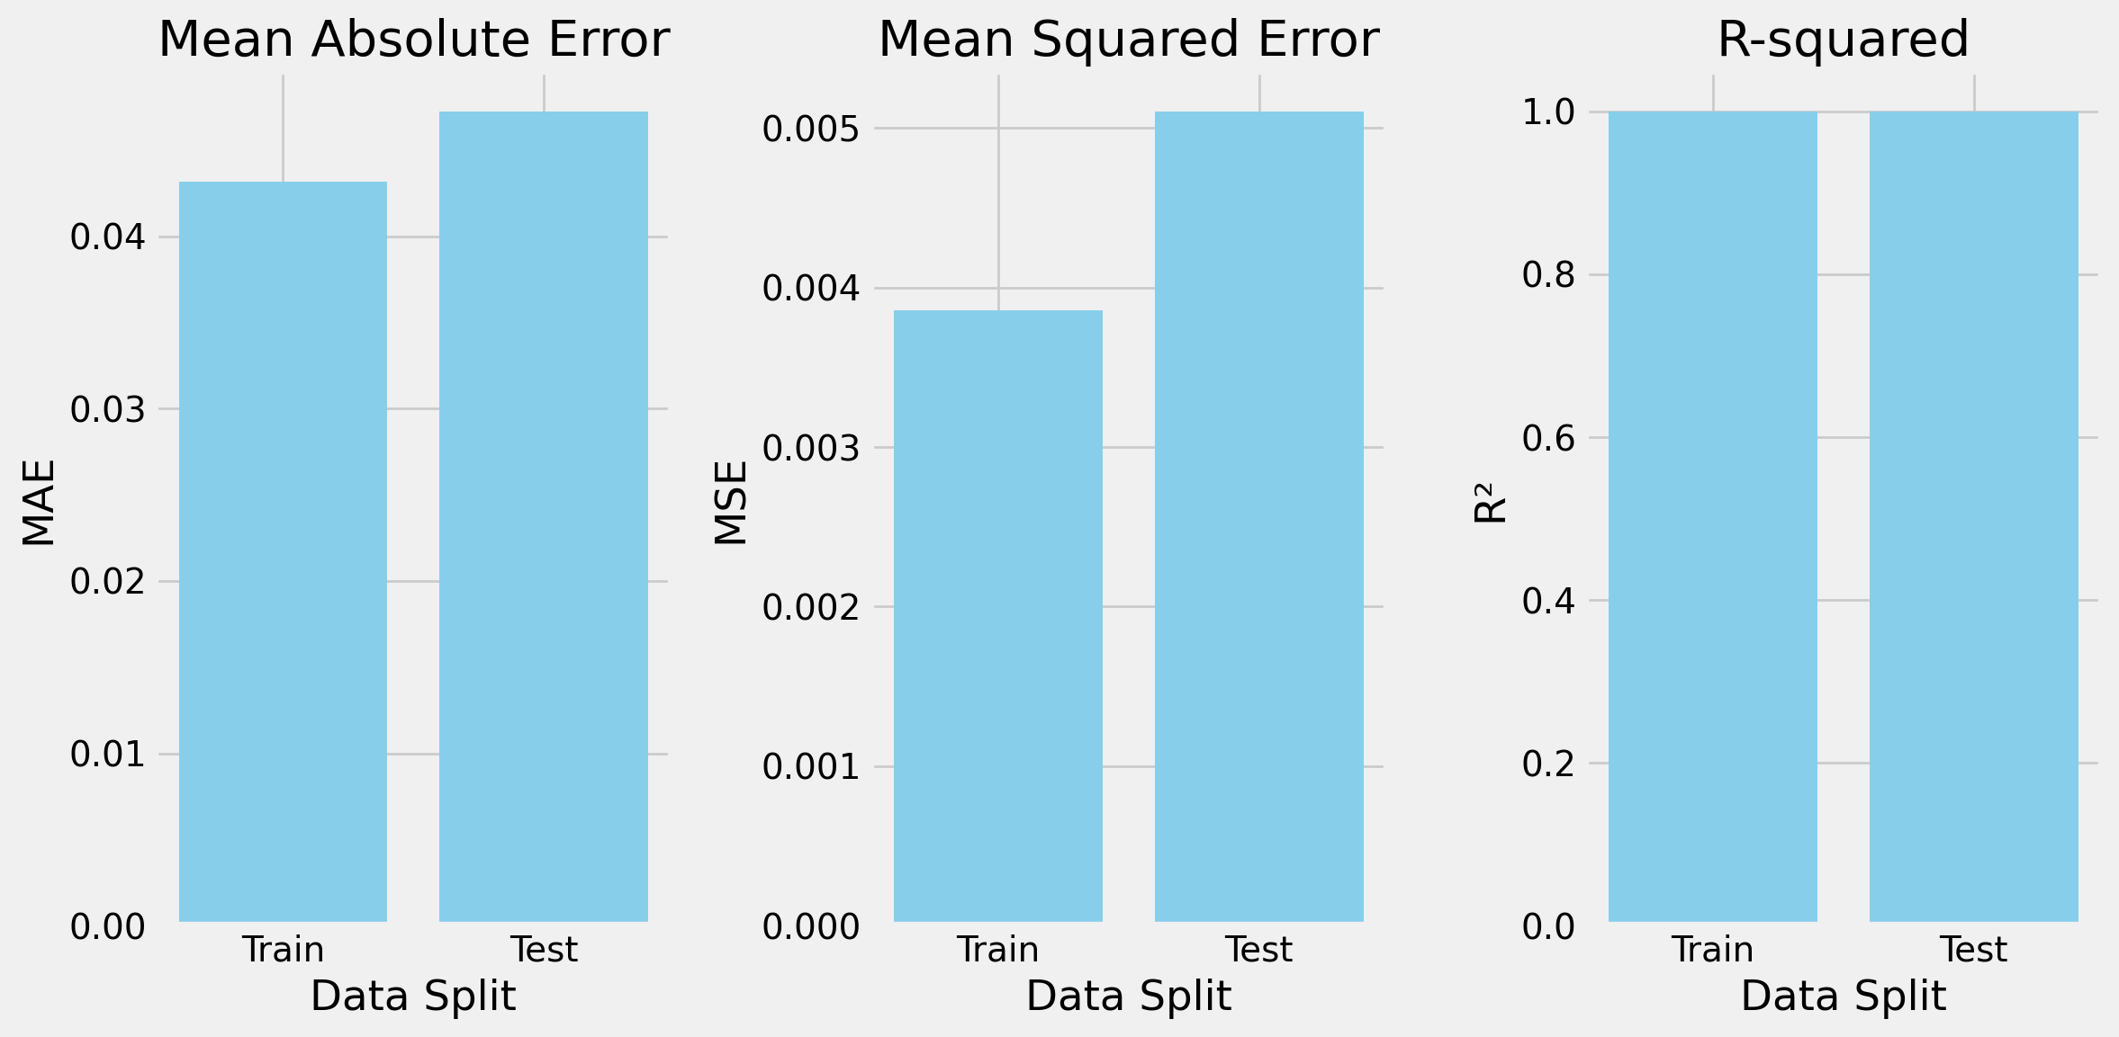
Best Model & Train-Test Split Evaluation
Train Mean Absolute Error (MAE): 0.04319
Train Mean Squared Error (MSE): 0.00386
Train R-squared (R2): 1.00000
Results showed XGBoost was the best model with a CV score of 0.99996.
Test Mean Absolute Error (MAE): 0.04724
Test Mean Squared Error (MSE): 0.00510
Test R-squared (R2): 1.00000

Slide 15
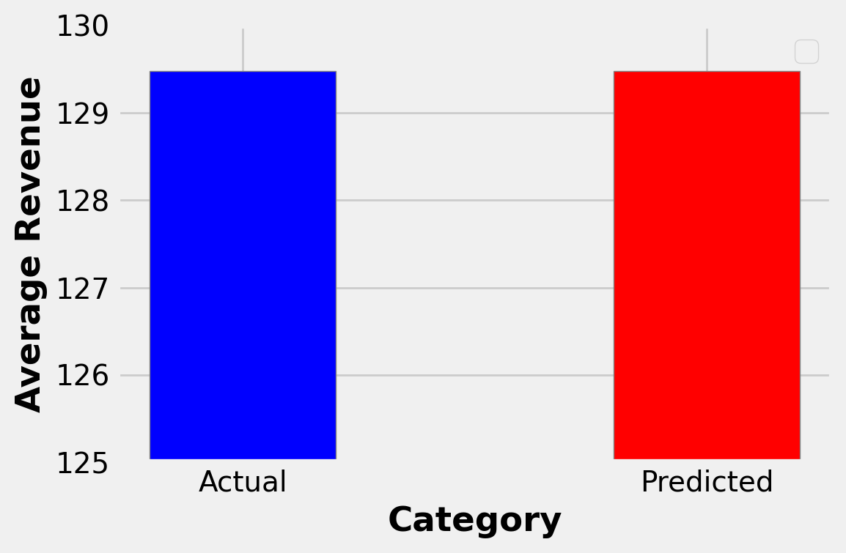
Actual & Predicted Revenue Averages
Predicted and actual revenue averages were equal, indicating a high level of accuracy in model’s ability to predict target variable’s scores within test subset.
Next Step: How much change would an increase in the number ‘Premium’ subscribers have on the predicted average?

Slide 16


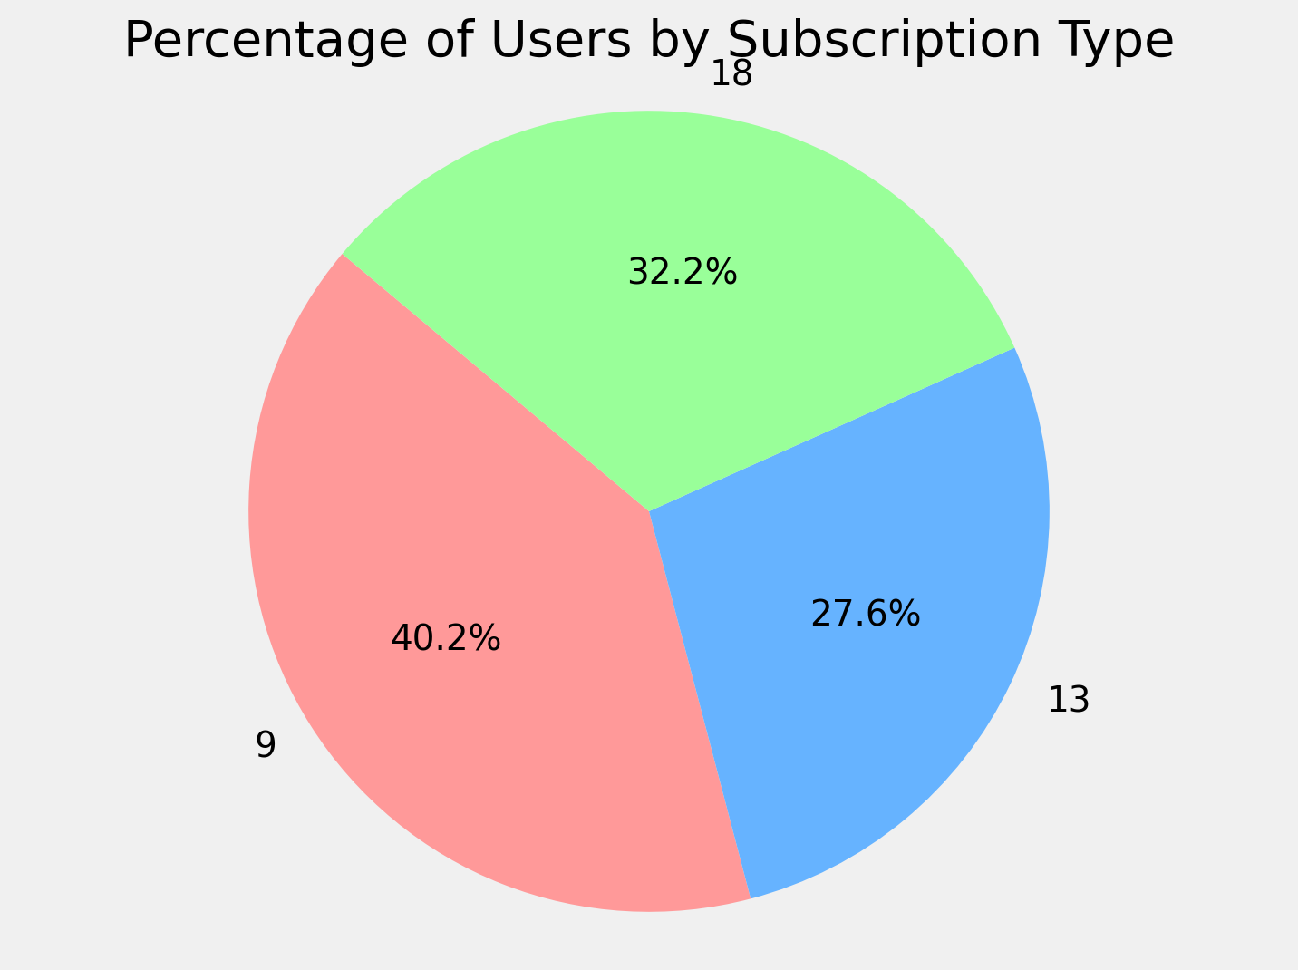
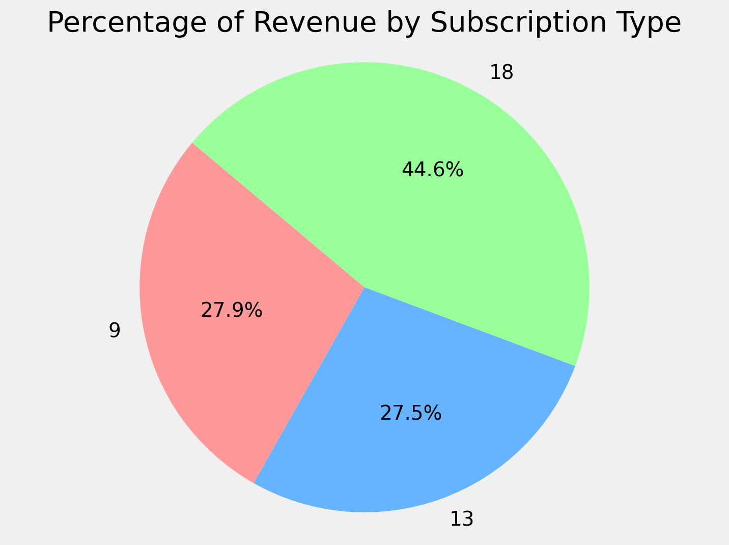
Upgraded Dataset
10% of ‘Standard’ (13) subscribers were upgraded to ‘Premium’ (18).
3.1% increase in ‘Premium’ users and 3.8% increase in total revenue.

Slide 17
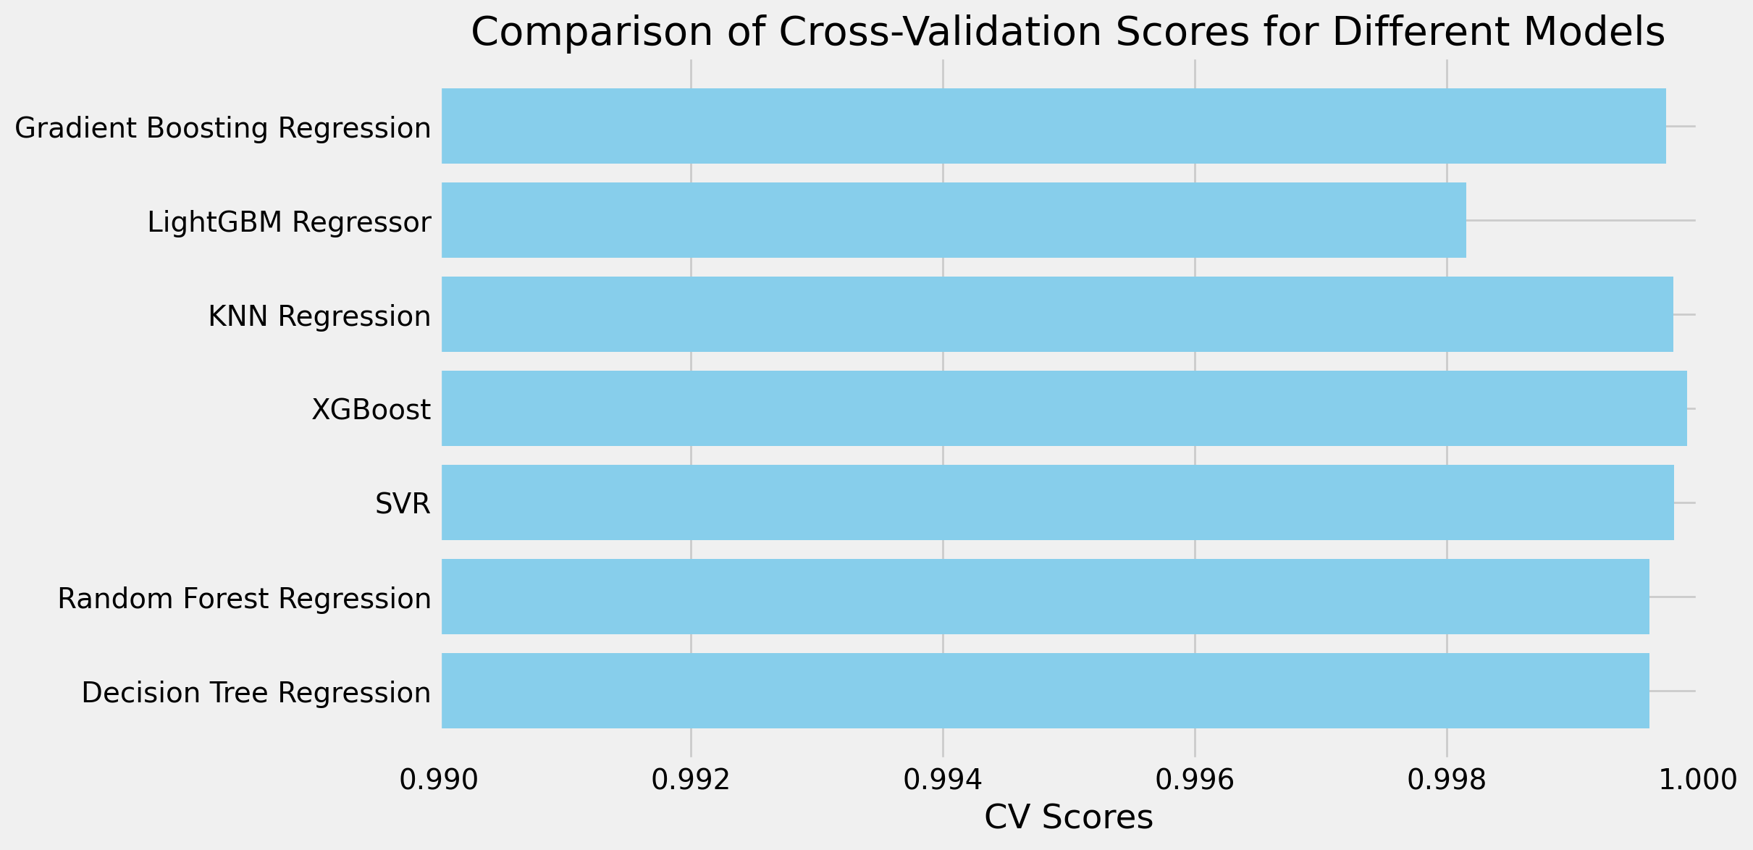
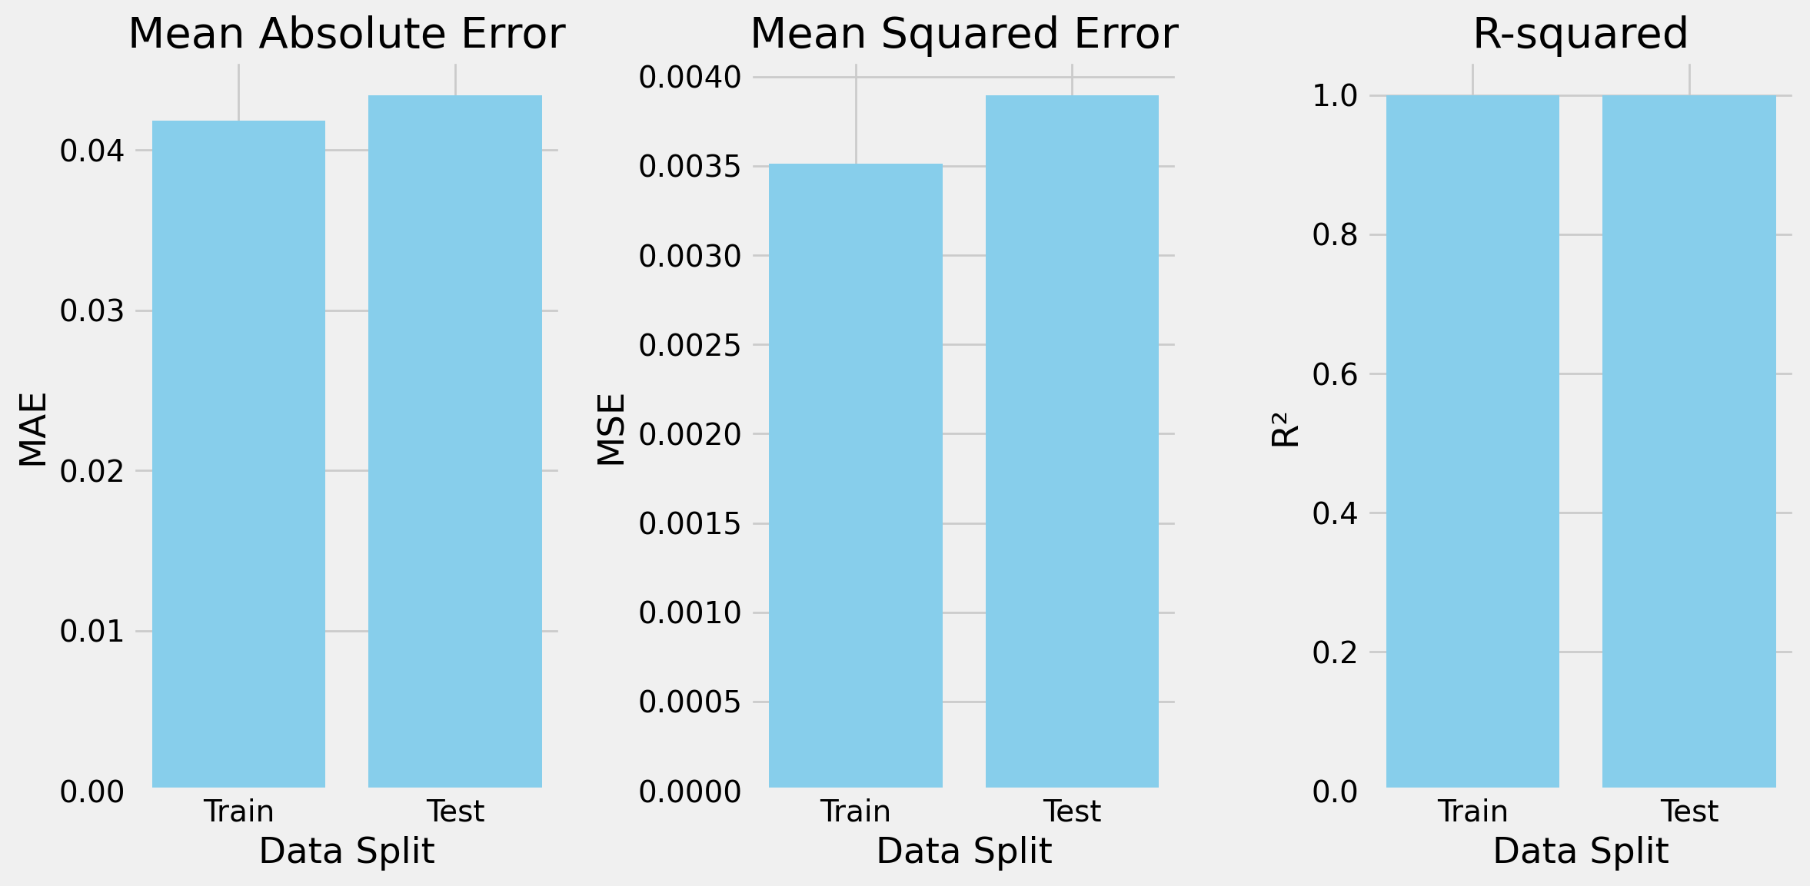
Best Model & Train-Test-Split Scores (After Upgrade)
Pipeline analysis showed XGBoost remained the best model with a CV score of 0.99991.
Train Mean Absolute Error (MAE): 0.04182
Train Mean Squared Error (MSE): 0.00351
Train R-squared (R2): 1.00000
Test Mean Absolute Error (MAE): 0.04342
Test Mean Squared Error (MSE): 0.00390
Test R-squared (R2): 1.00000

Slide 18
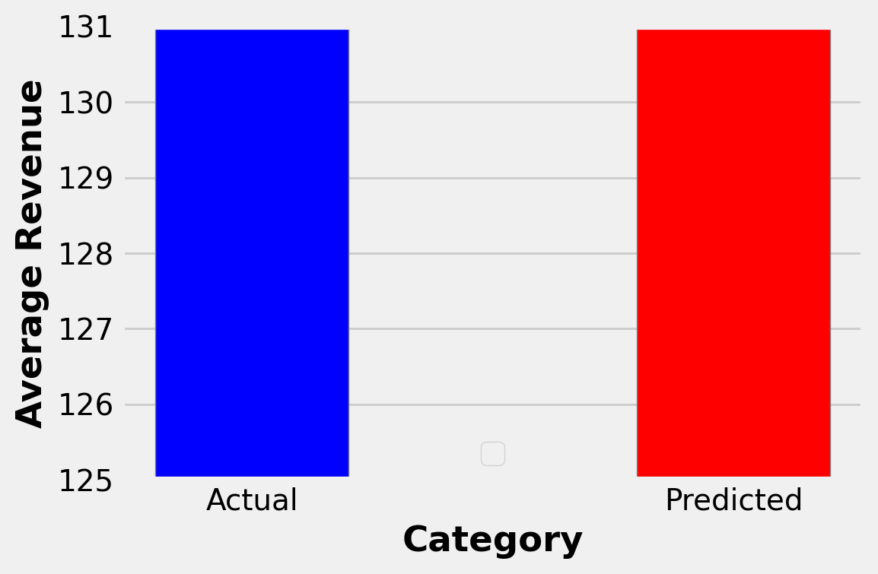
Actual & Predicted Revenue Average (After Upgrade)
Subscription upgrades showed a 1.16-point increase in both Actual and Predicted averages (130.99).
A 1.51% increase in total revenue.

Slide 19
Conclusions
Model results demonstrated a reliable accuracy in evaluating total revenue averages for a subset of subscribers within a given timeframe, suggesting that model is reproducible and fit for deployment. However, future analyses may benefit from the inclusion of more complex data that featured a larger sample, cancelled subscriptions, changes in account classes, rate of increase over a longer period (e.g. annually).
Given the importance monthly subscription revenue and number of payments have on predicting total revenue, implementing marketing strategies to encourage/incentivise current users to upgrade their accounts is recommended. Strategies can include promotional discounts, loyalty programs and access to interactive content that reward customers for upgrading.
Considerations for model deployment include cloud platforms such AWS, Google Cloud, or Azure.

Slide 20
References
https://www.kaggle.com/datasets/arnavsmayan/netflix-userbase-dataset
https://www.geeksforgeeks.org/regression-in-machine-learning/?ref=header_outind
https://www.w3schools.com/python/python_ml_train_test.asp
https://www.qualtrics.com/support/stats-iq/analyses/regression-guides/interpreting-residual-plots-improve-regression/
https://backlinko.com/netflix-users
https://www.similarweb.com/blog/insights/media-entertainment-news/streaming-q1-2023/
https://www.techopedia.com/who-owns-netflix-stock

Slide 21
End
Thank You

Slide 22
Questions?

